Slide 1
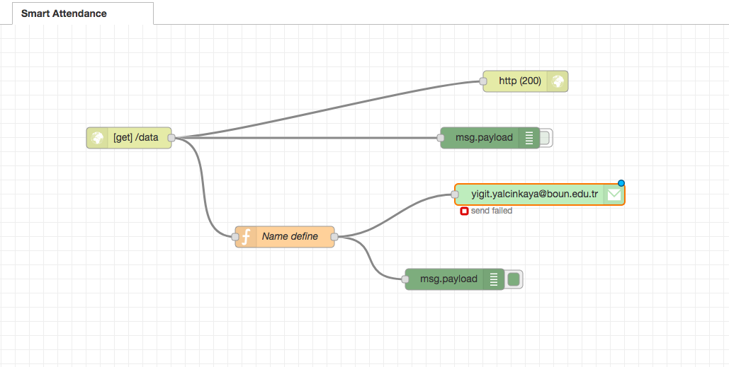
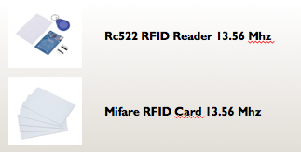
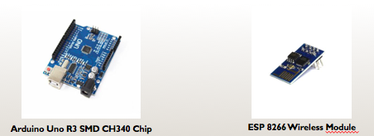
Smart Attendance
Can KARACA Yiğit YALÇINKAYA
Problem Definition
Checking the participation of the class is a time consuming activity
Application of this activity may not be done properly with traditional method
Solution
RFID integrated with cloud system which allows instructors to check attendance of the students on an online platform
List of HW and SW
RFID RC 522
ESP 8266
Arduino Uno
RFID Cards
IBM Bluemix
Arduino IDE
CmpE 490 IoT Course Final Project, 2018 Spring, Bogazici University Computer Engineering Department

